Slide 1

Computer Graphics
Dr. Lucy J. Gudino
Computer Science & Information Systems Group
Birla Institute of Technology & Science, Pilani, Goa Campus

Slide 2
Text and Reference Books
Text Books
  (T1) James D. Foley, A. Van Dam, S.K. Feiner, and J.F. Hughes, “Computer Graphics: Principles and Practice”, 2nd ed in C, Addision-Wesley Publishing Company, 1996.
  (T2) D. Hearn and M.P. Baker, “Computer Graphics with OpenGL”
Reference Books
  (R1) Rogers B., “Mathematical elements of Computer Graphics”, Tata McGraw Hill, 2002.
  (R2) N Krishnamurthy, “Introduction to Computer Graphics”, 1st Ed., TMH, 2002
  (R3) F. S. Hill, Jr., “Computer Graphics Using OpenGL”, 2nd Ed.Prentice –Hall of India, 2005

Slide 3
Evaluation Scheme
No. | Evaluation Component | Weightage (%) | Remarks
1 | Test I | 15 | CB
2 | Test II | 15 | CB
3 | Assignments/lab | 35 | Open book
3 | Comprehensive Exam | 35 | CB

Slide 4
Today’s lecture..

Slide 5
Introduction
What is computer graphics?
  Graphics using computer
  Pictures/images that are generated by a computer
  involves display, manipulation and storage of pictures and experimental data for proper visualization using a computer.
  Effective tool for presenting information or effective way of communicating the processed information to the user
Notes:
The computer is an information processing machine. It is a tool for storing, manipulating and correlating data. There are many ways in which information can be communicated to the user. The computer graphics is one of the most effective and commonly used way to communicate the processed information to the user. It displays the information in the form of graphics objects such as pictures, charts, graphs and diagrams instead of simple text

Slide 6
Definition
is a process associated with producing images by digital rendering of a picture model
is a process of generation of virtual scenes using computer hardware
is a human oriented system that uses the capabilities of a computer to create, transform, and display pictorial and symbolic data
is the use of computer hardware and software to create, manipulate, and present pictures and images.
is a pictorial representation and manipulation of data by a computer
Notes:
Rendering is the process of generating an image from a model

Slide 7
Introduction…
Need to know
  How graphics objects are prepared and presented?
  How interaction with the picture or graphics object is accomplished?

Slide 8
Introduction…
Tools used to make pictures
    Hardware tools:
      Video monitor and printer
      Computer itself
    Software tools
      OS, editor, compiler and debugger
      Graphics routines to produce pictures

Slide 9
Introduction…
Computer graphics system
  Host computer with fast processor
  Large memory, frame buffer
  Output devices : Display devices (colour monitors, LCD panels, laser printers, colour printers. Plotters etc.)
  Input devices (mouse, keyboard, joystick, touch screen, trackball)
  Interfacing devices such as, video I/O, TV interface etc.
Notes:
In computer graphics, pictures or graphics objects are presented as a collection of discrete picture elements called pixels. The pixel is the smallest addressable screen element. It is the smallest piece of the display screen which we can control➔ intensity and color. Example p1 and p2 line display
The process of determining the appropriate pixels for representing picture objects is known as rasterization.

Slide 10
Introduction…
Interactive Computer Graphics:
  User controls contents, structure, and appearance of objects and their displayed images via rapid visual feedback
  Example
  Basic components of an interactive graphics system
    input (e.g., mouse, tablet and stylus, force feedback device, scanner, live video streams…)
    processing (and storage)
    display/output (e.g., screen, paper-based printer, video recorder, non-linear editor…)

Slide 11
Introduction…
The advantages of interactive graphics
  A high quality graphics displays of personal computer provide one of the most natural means of communicating with a computer
  It provides tools for producing
    Real world objects
    Abstract, synthetic objects such as mathematical surfaces in 4D and data that have no inherent geometry
  Has an ability to show moving pictures, and thus it is possible to produce animations with interactive graphics
  Allows us to control the animation by adjusting
    the speed,
    the portion of the total scene in view
    geometric relationship of the objects in the scene to another
    the amount of details shown

Slide 12
Introduction…
The advantages of interactive graphics…
  Provides a tool called motion dynamics :
    user can move and tumble objects w.r.t. stationary observer
    Objects are stationary and the viewer moving around them
  Provides a facility called update dynamics:
    Possible to change the shape, color and other properties of the objects being viewed

Slide 13
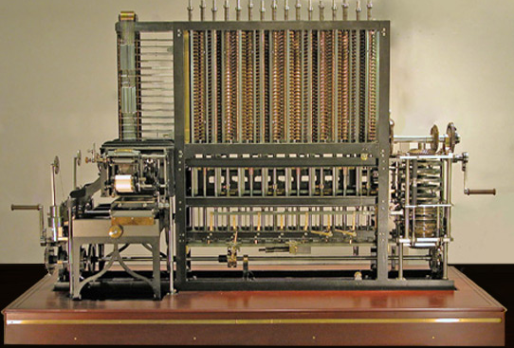
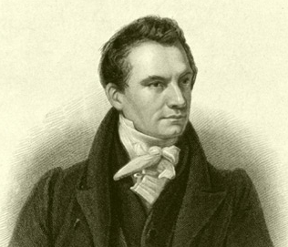
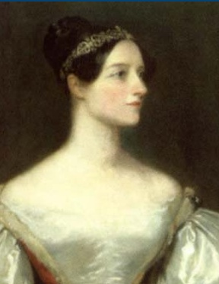
Historical Background of Computer Graphics
Charles Babbage and Ada Lovelace
Notes:
Charles Babbage: Father of computer designed first automatic computing engines (
Picture : http://www.computerhistory.org/babbage/?gclid=CIK86dm1qbgCFbF04godSB8AIg
Ada lovelace e byron first computer program in 1842 which did not have any support for graphics

Slide 14
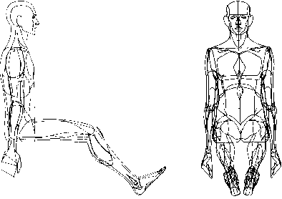
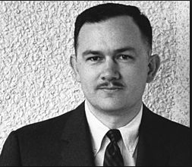
Historical Background of Computer Graphics
William Fetter (1928-2002 ) introduced the word Computer graphics
worked for Boeing ➔ Computer Graphics in 1960

Slide 15
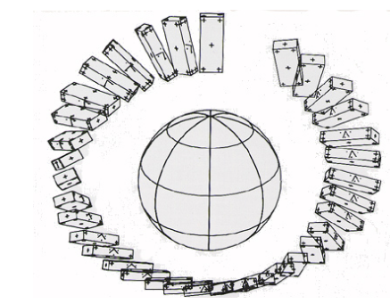
First Computer Animated Film
Edward Zajak of Bell labs “Two Gyro Gravity” in 1961

Slide 16
Contd…
First Computer Animation Language “MACS”
  Larry Breed of Stanford university in 1960
First Computer video game : “Spacewar”
  Steve Russel of MIT in 1961
First Conversational Graphical console (DAC-1) :”Sketch Pad” in 1963
  MIT and General motors
  Used as first CAD system
  Light pen developed by Ivan Sutherland
First Home video: “Odyssey”
  Ralph Baer in 1966

Slide 17
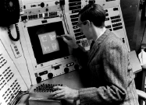
Contd..
First interactive graphics system, Sketchpad(1963), by Ivan Sutherland using CRT monitor, light pen and function-key panel
  constraint-based
  interaction techniques for choosing, pointing, drawing
    Light pen, buttons, knobs
  data structures for replicating components
  hierarchical modeling

Slide 18
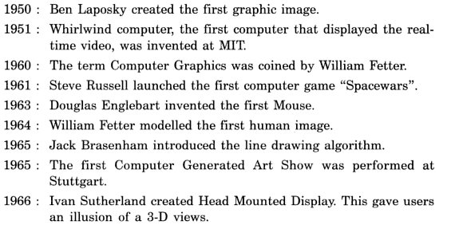
Contd…

Slide 19
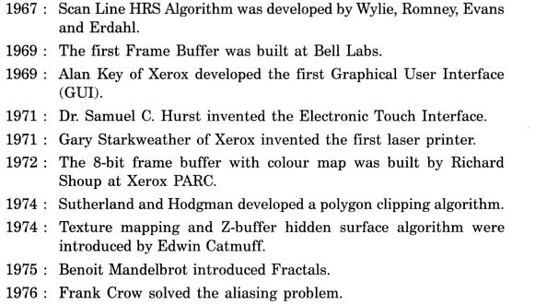
Contd…

Slide 20
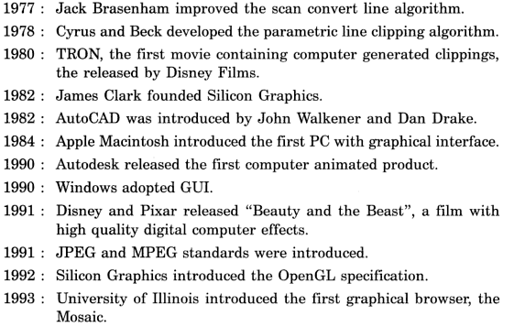
Contd…

Slide 21
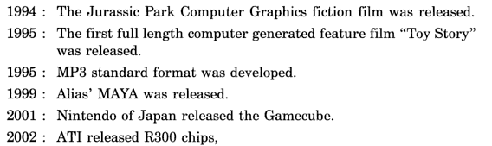
Contd…

